Slide 1

Breast Cancer Detection Using Machine Learning Algorithms
A Standardized Comparative Study
Presented by Amaragonda Adhithya
Course: Comprehensive Seminar | February 2026

Slide 2


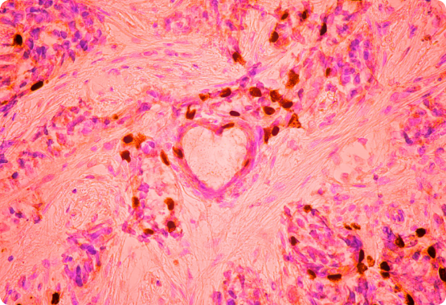
INTRODUCTION
Breast cancer is a leading cause of cancer-related mortality worldwide. Early detection is paramount, significantly increasing survival rates and treatment success.
Machine Learning (ML) acts as a powerful diagnostic aid, identifying malignant tumor patterns with high precision and consistency.
Predictive analytics enables medical professionals to leverage computational power for faster, more accurate clinical decision-making.

Slide 3



PROBLEM STATEMENT
Fragmented Scope
Metric Bias
Lack of Standard
Most existing studies only compare 2–3 algorithms, leading to an incomplete understanding of model performance.
Research often focuses solely on accuracy, ignoring critical clinical factors like False Negative rates.
Inconsistent preprocessing and limited validation hinder the reproducibility of diagnostic frameworks.
A unified and statistically validated comparative framework is required.

Slide 4
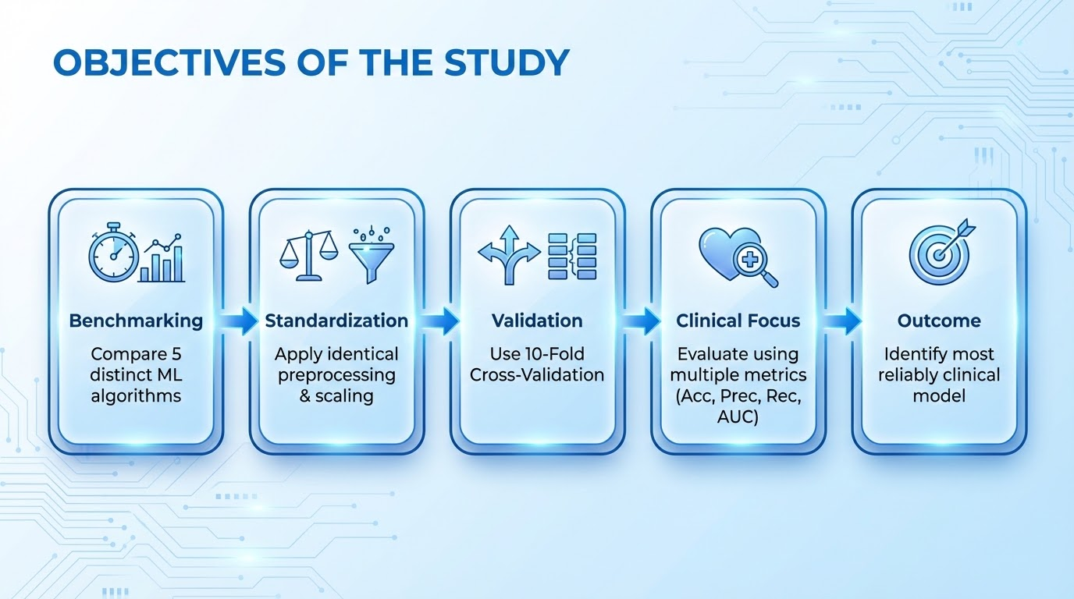

Slide 5
LITERATURE SURVEY (LIMITATIONS)
Selected Research Papers | Key Limitations Identified
Breast Cancer Detection: ML Algorithms | Limited algorithms; No statistical validation; Basic preprocessing.
Comparing Prediction Models | No standardized framework; Limited cross-validation; No medical context.
BC Prediction Using Decision Trees | Only single classifier focus; Lack of multi-metric evaluation.
ML Models (Elsevier Procedia CS, 2021) | No unified preprocessing; Lack of reproducibility framework.
Performance Analysis of Different ML | Accuracy-centered; No significance testing; Limited interpretability.

Slide 6

RESEARCH GAP IDENTIFIED
Narrow Algorithm Comparison: Lack of breadth in model testing.
Accuracy Over-Reliance: Missing clinical sensitivity focus.
Preprocessing Variance: Results vary due to inconsistent cleaning.
Lack of Cross-Validation: High risk of "lucky" split results.
Limited Discussion: Minimal analysis on medical interpretability.

Slide 7



OUR RESEARCH CONTRIBUTION
The Baseline
Standardized Pipeline
Clinical Insight
Implementation of 5 ML algorithms (LR, KNN, DT, RF, SVM) under a unified testing framework.
Identical preprocessing, same dataset, same train-test split, and 10-fold cross-validation for all.
Evaluation focused on False Negative reduction, ensuring fairness, reliability, and transparency.

Slide 8




DATASET DESCRIPTION
569
30
0
Total Instances
Numerical Features
Missing Values
Wisconsin Breast Cancer Dataset: Features describe characteristics of cell nuclei from biopsies, with a binary target: Malignant or Benign.

Slide 9
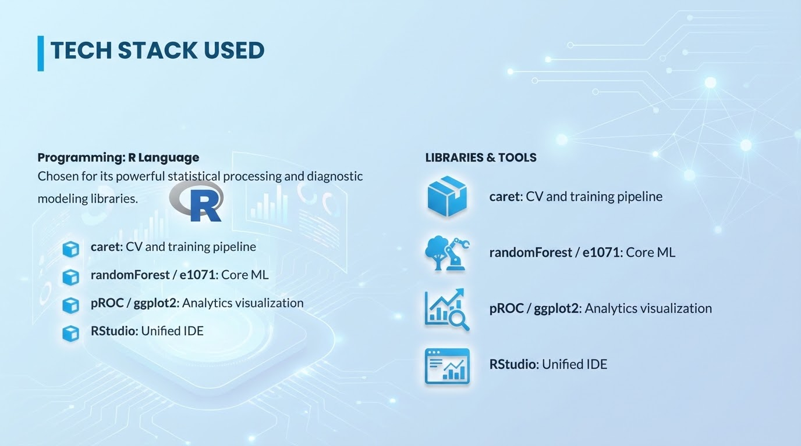

Slide 10
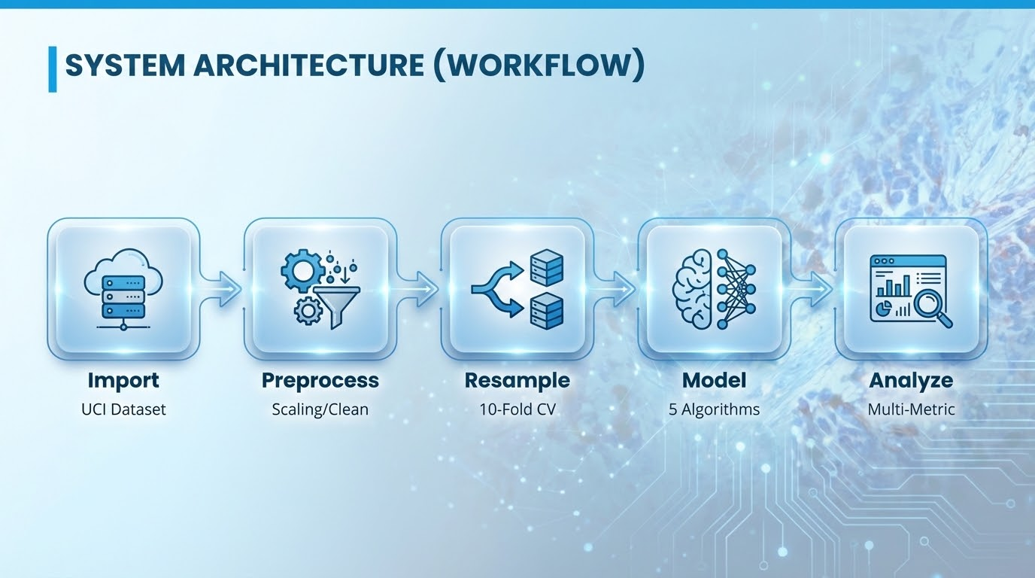

Slide 11


EVALUATION METRICS USED
Accuracy: Overall classification correctness.
Recall (Sensitivity): Key for detecting cancer cases.
Precision: Accuracy of positive predictions.
F1-Score: Harmonic mean of Precision and Recall.
ROC-AUC: Model distinguishing probability.

Slide 12

CONFUSION MATRIX INTERPRETATION
The matrix tracks True Positives (Correct Malignant), True Negatives (Correct Benign), and errors.
TP → Malignant detected
TN → Benign confirmed
Medical Importance
FP → Unnecessary Stress
Minimizing False Negatives is our highest priority. A missed cancer case is more dangerous than a false alarm.
FN → Dangerous Miss

Slide 13
PROJECT IMPLEMENTATION TIMELINE
Week | Activity Phase | Key Deliverable
Week 1 | Literature Review & GAP Identification | Hypothesis Baseline
Week 2 | Dataset Preparation & EDA | Normalized Dataset
Week 3 | Algorithm Implementation in R | Working Scripts
Week 4 | 10-Fold Cross-Validation & Tuning | Optimized Models
Week 5 | Comparative Result Analysis | Final Metrics
Week 6 | Documentation & Presentation | Project Handover

Slide 14

ADVANTAGES OF THE STUDY
Fair Comparison: Identical conditions for all models.
Reliability: Cross-validation ensures non-anomalous results.
Reproducibility: Standardized R pipeline.
Clinical Value: Medically meaningful metric focus.

Slide 15



LIMITATIONS OF THE STUDY
Data Scope
Model Scope
Real-World Gap
Limited dataset size (569 samples) and lack of multi-center clinical data.
Focused exclusively on classical ML; No Deep Learning or CNN architectures tested.
Results have not been validated in a live hospital environment or clinical trial.

Slide 16
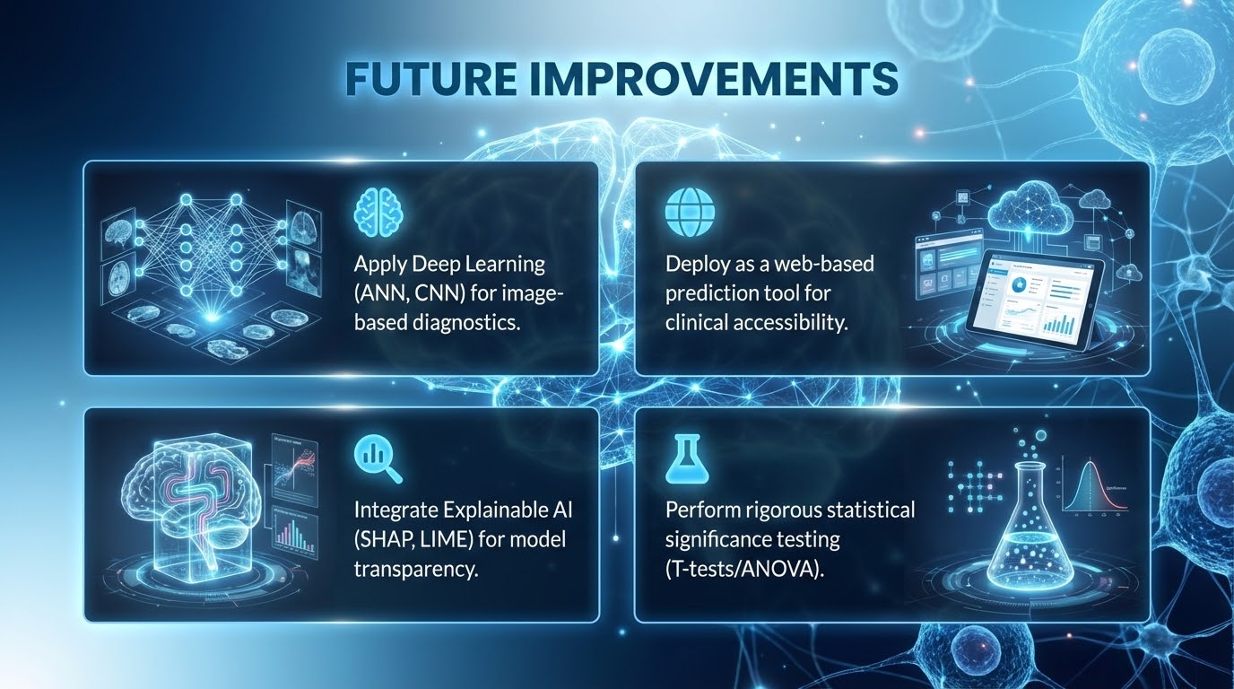
Apply Deep Learning (ANN, CNN) for image-based diagnostics.
Deploy as a web-based prediction tool for clinical accessibility.
Integrate Explainable AI (SHAP, LIME) for model transparency.
Perform rigorous statistical significance testing (T-tests/ANOVA).

Slide 17


CONCLUSION
Machine Learning models are effectively capable of classifying breast cancer tumors with high precision.
Our standardized evaluation reveals that Support Vector Machines (SVM) and Random Forest typically offer the most robust clinical reliability.
Consistency in preprocessing is vital for identifying AI-based tools that truly support early diagnosis.

